Slide 1
Introduction of Cypress

Slide 2
Module 1: Introduction of Cypress
What is cypress.
Who uses cypress.
Features of cypress
Cypress ecosystem
Installing cypress
How to open cypress
Project folder
Write First test code.

Slide 3
What is cypress.
Cypress is an open-source and free test automation tool.
It can be used for Front end and API test automation.
NodeJS-based modern automation tool.
Supports JavaScript/Typescript.
faster and easier.

Slide 4


Who uses cypress.
QA engineers Developers

Slide 5
Features of cypress
Time Travel:
Debuggability:
Automatic Waiting:
Consistent Results:
Screenshots and Videos:

Slide 6
Cypress ecosystem
Test Runner.
Dashboard Service.

Slide 7
How to open cypress
pre requirements:-
Node.js
Code editore like Vscode
step 1. create new folder and open it by vscode
step 2. npm -i init,
step 3. npm install cypress –save-dev,
step 4. node_modules/.bin/cypress open,

Slide 8
How to open cypress
Two way to open cypress
1. In Test Runner app.
npx cypress open
node_modules/.bin/cypress open
2. in Terminal.
npx cypress open
Once the cypress runner is open, new folder named “cypress”. created

Slide 9
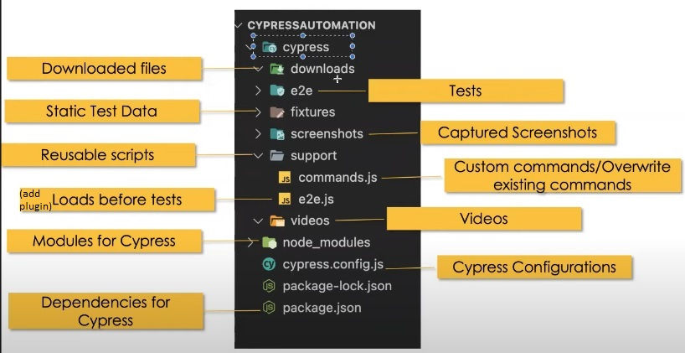
Project folder

Slide 10
Write First test code.
describe('My First Test', () => {
it('Does not do much!', () =>
{
expect(true).to.equal(true)
})
})
we can yous arrow or Anomalous function to write describe or it.

Slide 11
https://www.tutorialspoint.com/cypress/index.htm
https://toolsqa.com/cypress-tutorial/
https://docs.cypress.io/examples/tutorials
https://mindmajix.com/cypress-tutorial

